Slide 1

IT2060
Operating Systems and System Administration
Lecture 03
Threads

Slide 2
Chapter 4: Threads
Threads Concept
Why threads
Thread models

Slide 3
Motivation to Threads
Most modern applications are multithreaded
Threads run within application
Multiple tasks with the application can be implemented by separate threads
  Update display
  Fetch data
  Spell checking
  Answer a network request
Process creation is heavy-weight while thread creation is light-weight
Can simplify code, increase efficiency
Kernels are generally multithreaded

Slide 4
Threads
A thread of control is an independent sequence of execution of program code in a process.
A thread (or lightweight process) is a basic unit of CPU utilization.
  A traditional process (or heavyweight process) is equal to a task with one thread.
A traditional process has a single thread that has sole possession of the process’s memory and other resources → context switch becomes performance bottleneck
  Threads are used to avoid the bottleneck.
  Threads share all the process’s memory, and other resources.
Threads within a process:
  are generally invisible from outside the process.
  are scheduled and executed independently in the same way as different single-threaded processes.
On a multiprocessor, different threads may execute on different processors
  On a uni-processor, threads may interleave their execution arbitrarily.

Slide 5
Threads (cont.)
Threads operate, in many respects, in the same manner as processes:
  Threads can be in one of several states: ready, blocked, running, or terminated, etc.
  Threads share CPU; only one thread at a time is running.
  A thread within a process executes sequentially, and each thread has its own PC and Stack.
  Thread can create child threads, can block waiting for system calls to complete
    if one thread is blocked, another can run.
One major different with process: threads are not independent of one another
  all threads can access every address in the task → a thread can read or write any other thread’s stack.
  There is no protection between threads (within a process);
    however this should not be necessary since processes may originate from different users and may hostile to one another while threads (within a process) should be designed (by same programmer) to assist one another.

Slide 6
Threads (cont.)
Three processes with one thread each
Process
Thread
PC
One process with three threads

Slide 7
Benefits of Threads
Responsiveness – may allow continued execution if part of process is blocked, especially important for user interfaces
Resource Sharing – threads share resources of process, easier than shared memory or message passing
Economy – cheaper than process creation, thread switching lower overhead than context switching
Scalability – process can take advantage of multiprocessor architectures

Slide 8
Single and Multithreaded Processes

Slide 9
User Threads and Kernel Threads
User threads - management done by user-level threads library
Three primary thread libraries:
  POSIX Pthreads
  Windows threads
  Java threads
Kernel threads - Supported by the Kernel
Examples – virtually all general purpose operating systems, including:
  Windows
  Solaris
  Linux
  Tru64 UNIX
  Mac OS X

Slide 10
Multithreading Models
Many-to-One
One-to-One
Many-to-Many

Slide 11
Many-to-One
Many user-level threads mapped to single kernel thread
One thread blocking causes all to block
Multiple threads may not run in parallel on muticore system because only one may be in kernel at a time
Few systems currently use this model
Examples:
  Solaris Green Threads
  GNU Portable Threads

Slide 12
One-to-One
Each user-level thread maps to kernel thread
Creating a user-level thread creates a kernel thread
More concurrency than many-to-one
Number of threads per process sometimes restricted due to overhead
Examples
  Windows
  Linux
  Solaris 9 and later

Slide 13
Many-to-Many Model
Allows many user level threads to be mapped to many kernel threads
Allows the operating system to create a sufficient number of kernel threads
Solaris prior to version 9
Windows with the ThreadFiber package

Slide 14
Thread Libraries
Thread library provides programmer with API for creating and managing threads
Two primary ways of implementing
  Library entirely in user space
  Kernel-level library supported by the OS
Pthread is the library provided by UNIX (Solaris, Linux, Mac OS X) threads.
It provides the threads either as user-level or kernel-level
A POSIX standard (IEEE 1003.1c) API for thread creation and synchronization
API specifies behavior of the thread library, implementation is up to development of the library

Slide 15
Thread Pools
Create a number of threads in a pool where they await work
Advantages:
  Usually slightly faster to service a request with an existing thread than create a new thread
  Allows the number of threads in the application(s) to be bound to the size of the pool
  Separating task to be performed from mechanics of creating task allows different strategies for running task
    i.e.Tasks could be scheduled to run periodically

Slide 16
Signal Handling
Signals are used in UNIX systems to notify a process that a particular event has occurred.
A signal handler is used to process signals
  Signal is generated by particular event
  Signal is delivered to a process
  Signal is handled by one of two signal handlers:
    default
    user-defined
Every signal has default handler that kernel runs when handling signal
  User-defined signal handler can override default
  For single-threaded, signal delivered to process

Slide 17
Signal Handling (Cont.)
Where should a signal be delivered for multi-threaded?
  Deliver the signal to the thread to which the signal applies
  Deliver the signal to every thread in the process
  Deliver the signal to certain threads in the process
  Assign a specific thread to receive all signals for the process

Slide 18
Thread Cancellation
Terminating a thread before it has finished
Thread to be canceled is target thread
Two general approaches:
  Asynchronous cancellation terminates the target thread immediately
  Deferred cancellation allows the target thread to periodically check if it should be cancelled

Slide 19
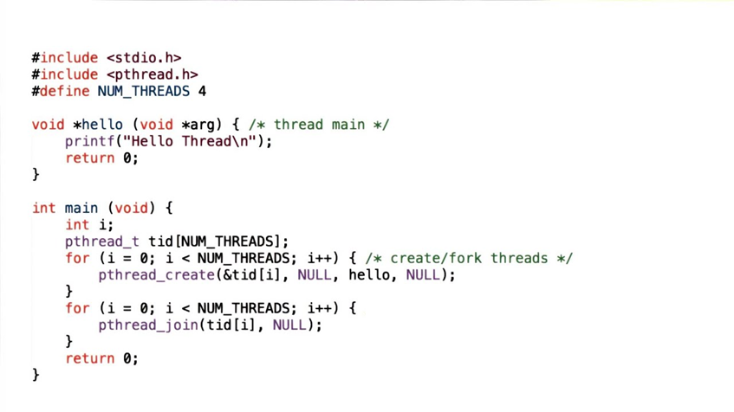
Thread Example

Slide 20
End of Lecture 4

